Slide 1



Bank Management system for android application
CSA0970-JAVA PROGRAMMING
Guided By:
Dr. A.Ganesh Ramachandran
(Course Faculty)
CSA0910-Programming in Java for Software Develop
Saveetha School of Engineering
Done By:
K. Abhilash : 192211560
CSA0910-Programming in Java
Saveetha School of Engineering

Slide 2
ABSTRACT :
Bank management focusing on enhancing customer experience and operational efficiency. The app enables secure account management, fund transfers, bill payments, and transaction tracking for users. Administrators benefit from tools for account management, transaction monitoring, reporting, and regulatory compliance. With strong security features like secure authentication and encryption, the application ensures user information remains confidential and secure. This system promises to significantly improve mobile banking services by offering convenience, security, and satisfaction to both customers and administrators.
Keywords :
Mobile Banking, Account Management, Transaction History, Balance Inquiry, Fund transfer, Bill Payment, ATM Locator, Account Statement, Customer Support, Security Features.

Slide 3
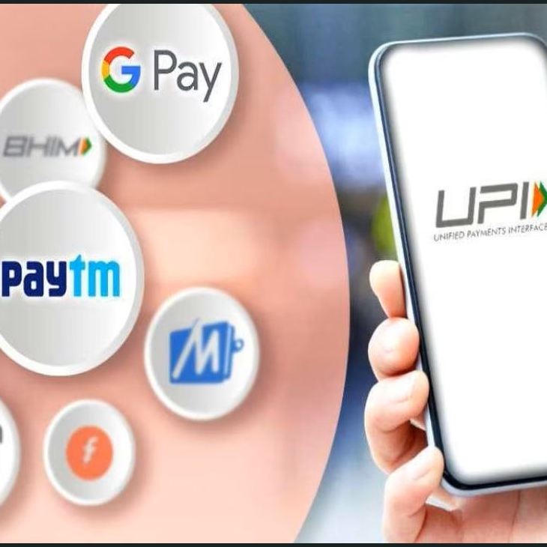
Introduction
Modern Banking Convenience: Enjoy efficient banking operations on your mobile device.
Secure Transactions: Robust security ensures safe fund transfers and transactions.
User-Friendly Interface: Intuitive design for easy navigation and accessibility.
Real-Time Updates: Stay informed with instant notifications of account activities.
Customizable Features: Personalize alerts and settings to suit your banking preferences.

Slide 4
APPLICATIONS:
Account Management
Fund Transfer
Bill Payment
Mobile Deposit
Notifications and Alerts
BENEFITS:
Convenient access to financial information anytime.
Facilitates quick and secure transactions.
Saves time by consolidating bill payments in one platform.
Speeds up deposit processes.
enhancing transparency and security against fraud.

Slide 5
LITERATURE REVIEW
AUTHOR/YEAR | TITLE | FINDINGS
Sathiamoorthy et al. (2016) | Design and Implementation of Mobile Banking Application for Android Environment | Proposed an Android app with features like balance inquiry and fund transfers, emphasizing security protocols.
Kaur and Kaur (2018) | Android Based Banking System for Efficient Banking Management | Developed an app integrating account management, transaction history, and ATM locator services, enhancing accessibility and customer satisfaction.
Khan et al. (2020) | Design and Implementation of Mobile Banking Application Using Android Technology | Introduced biometric authentication and real-time transaction alerts to enhance security and user experience.

Slide 6
AUTHOR/YEAR | TITLE | FINDINGS
Kumari and Rani (2019) | Development of Android Based Bank Management System | Created an app covering customer registration, loan management, and employee management, emphasizing scalability and efficiency.
Verma and Kaur (2017) | Android Based Banking Application for Seamless Transactions | Developed a user-friendly app with QR code payments and NFC technology for seamless transactions, integrating emerging technologies for enhanced user experience.

Slide 7
PROBLEMS IDENTIFIED
Security Vulnerabilities: Potential for data breaches and malware threats.
Performance Issues: Slow response times and crashes.
Compatibility Challenges: Problems with different Android versions and devices.
Authentication Weaknesses: Issues with user authentication and password security.
Transaction Reliability: Concerns over transaction processing delays or failures.
Data Synchronization: Inconsistencies between mobile app data and backend systems.
Regulatory Compliance: Risks of non-compliance with financial regulations and standards.

Slide 8
CURRENT TRENDS
Based on the information provided, here are the top 6 current trends in Bank Management System for Android applications:
Mobile-First Approach: Banks are increasingly focusing on mobile-first strategies, optimizing their systems for seamless and intuitive user experiences on Android devices.
Enhanced Security Features: Integration of advanced security measures such as biometric authentication (fingerprint, facial recognition), tokenization, and real-time fraud detection to safeguard transactions and customer data.
Personalization: Utilizing data analytics and AI to offer personalized banking experiences, including targeted offers, customized financial advice, and personalized notifications.

Slide 9
API Integration: Embracing open banking initiatives and APIs to facilitate integration with third-party services, enhancing functionality and offering customers a broader range of financial services.
Blockchain and Cryptocurrency Integration: Exploring blockchain technology for enhanced security in transactions and the potential integration of cryptocurrencies within banking systems.
Chatbot and AI Assistants: Implementing chatbots and AI-powered assistants to provide instant customer support, automate routine inquiries, and improve overall customer engagement.
Cloud Adoption: Increasing adoption of cloud-based solutions for scalability, flexibility, and cost-efficiency in managing banking operations and customer data securely.

Slide 10
EXISTING SYSTEM
Account Management: Users can view account balances, transaction history, and download statements.
Fund Transfers: Enables transfers between accounts within the same bank or to external accounts.
Bill Payments: Allows users to pay bills for utilities, credit cards, loans, etc., directly through the app.
Mobile Deposits: Users can deposit checks by capturing photos with their device's camera.
Disadvantages:
The main drawbacks including security risks like data breaches, compatibility issues across devices and OS versions, dependency on internet connectivity, complex regulatory compliance, transaction limits and fees, and potential technical vulnerabilities and customer support limitations.

Slide 11
PROPOSED SYSTEM
Secure login using biometric authentication (fingerprint/face recognition) and PIN/password for enhanced security.
View account balances, transaction history, and manage personal information and preferences.
Transfer funds between accounts within the bank or to external accounts securely and conveniently.
Enable customers to pay bills for utilities, credit cards, loans, and other services directly from the app.
Facilitate online loan applications, document uploads, eligibility checks, and status tracking with notifications.
Implement SSL/TLS encryption for data transmission, secure storage of sensitive information, and continuous monitoring for fraud detection.

Slide 12
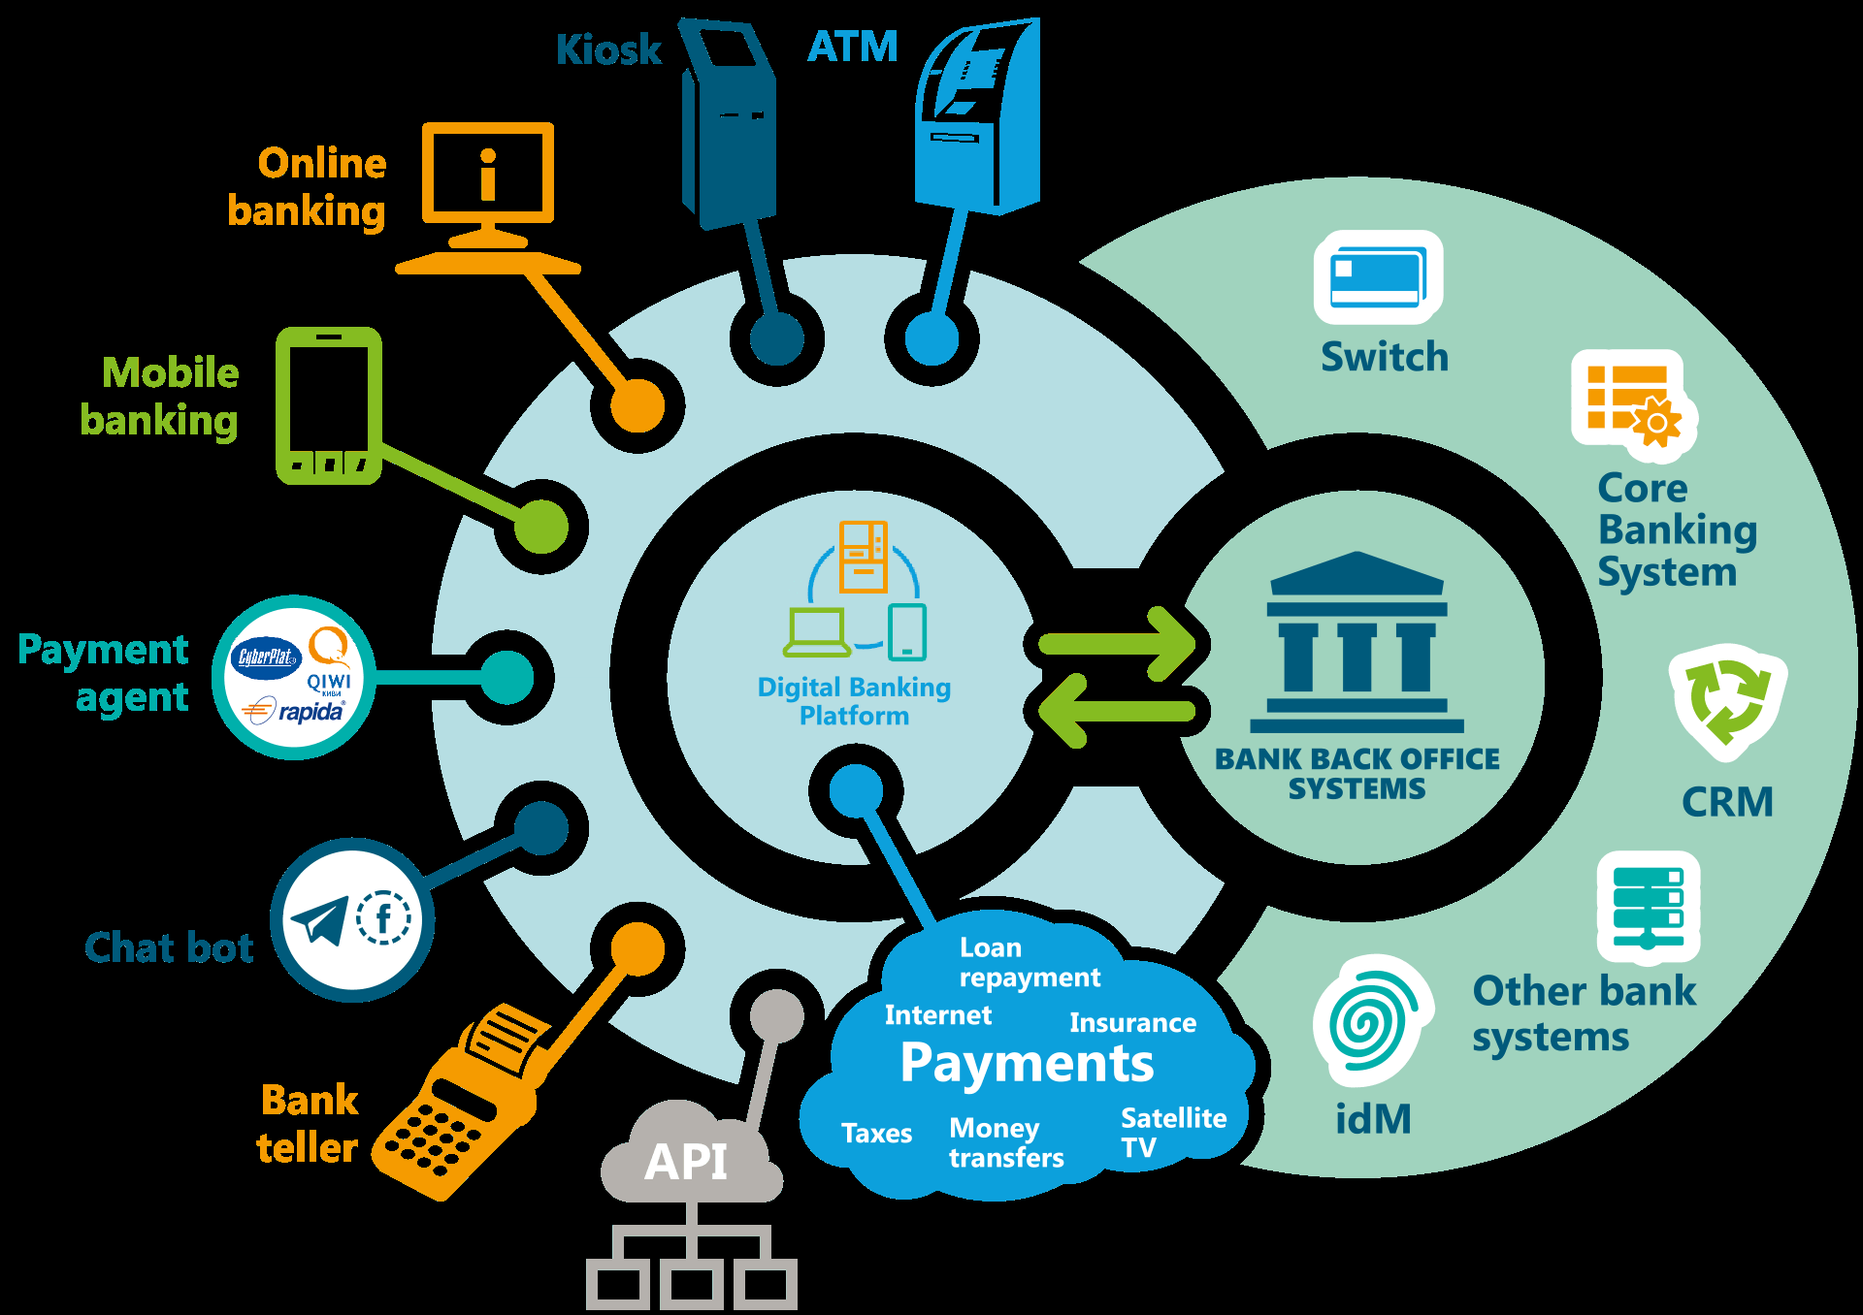
SYSTEM ARCHITECTURE

Slide 13
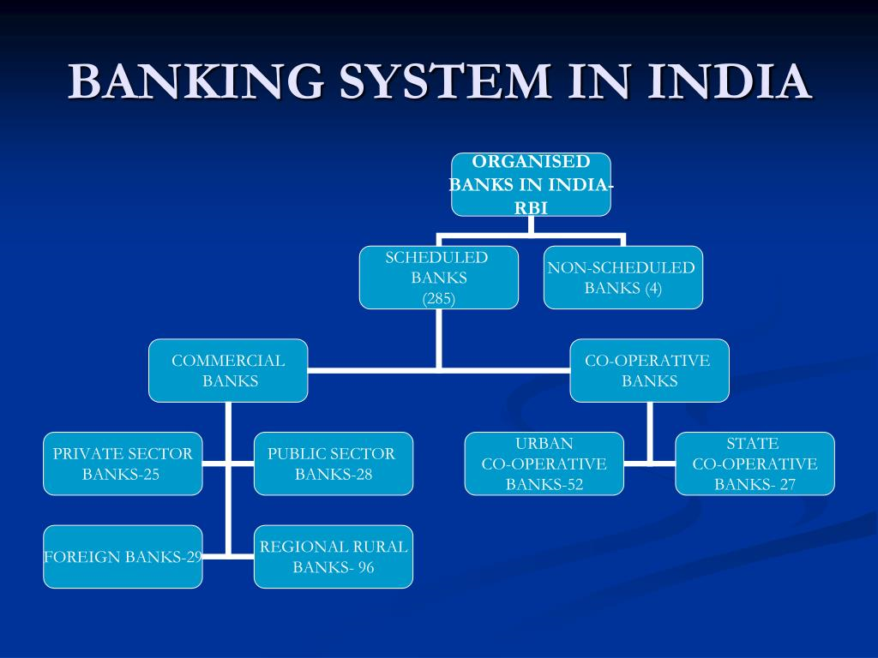
FLOWCHART

Slide 14
Modules
User Authentication and Authorization
Account Management
Fund Transfer
Deposit and Withdrawals
Loan Management
Bill Payments
Customer Support
Budgeting and Financial Planning

Slide 15
Load Dataset : Here, a dataset with multiple attributes is created and processed in accordance with real-world data transmissions.
Data Clustering: As a result, clustering may be used to solve a multi-objective optimization issue. The unique data collection and intended application of the findings define the optimal clustering technique and parameter setup.

Slide 16
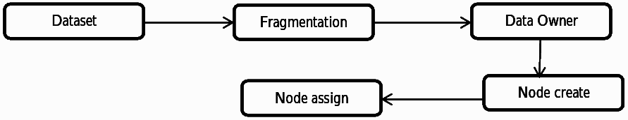
Node Selection: The technique is repeated for each file fragment. The centrality metric is the same for each node. The same node is chosen to store the file fragment. As a result, the performance was the same, and all three lines intersected at the same position sign.
Data Validation: Payment details such as account number are checked using a series of different algorithms that determine whether it is possible for an account to exist with that combination of numbers.
Dataset
Consistency Checks
Range Checks

Slide 17
ADVANTAGES
Enables customers to manage their accounts anytime, anywhere.
Swift transactions and account management directly from the app.
Robust measures to safeguard transactions and personal data.
Real-time notifications and customer support enhance user experience.
Reduces operational costs and promotes a paperless environment.
Quick query resolution and support integration.

Slide 18
LIMITATIONS
Ensuring robust protection against cyber threats and unauthorized access.
Addressing variations in Android devices and screen sizes.
Dependency on stable internet for real-time transactions.
Educating users on app usage and security best practices.
Adhering to strict data protection laws and regulations.
Providing effective support for app-related issues and updates.

Slide 19
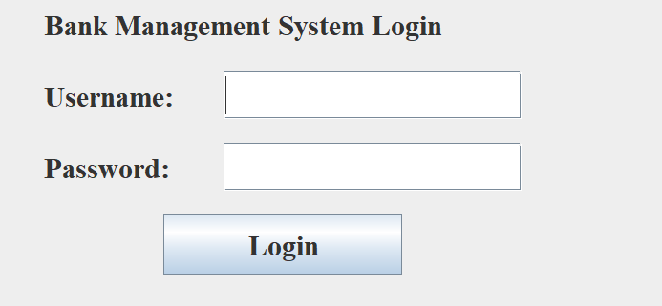
RESULTS
Fig 1: Bank Management System login page

Slide 20
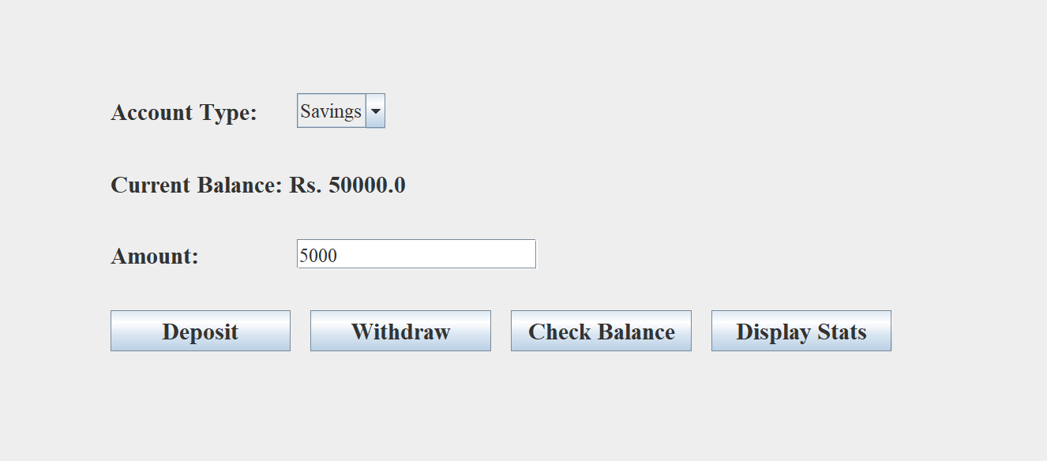
RESULTS
Fig 2: Deposit Form

Slide 21
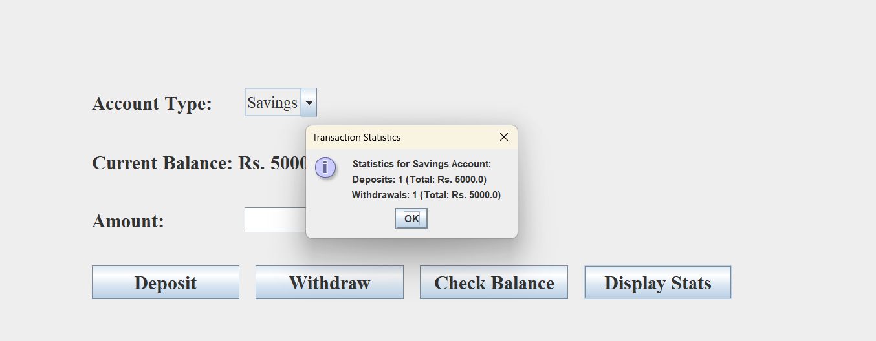
RESULTS
Fig 3:Statistics for Savings Account

Slide 22
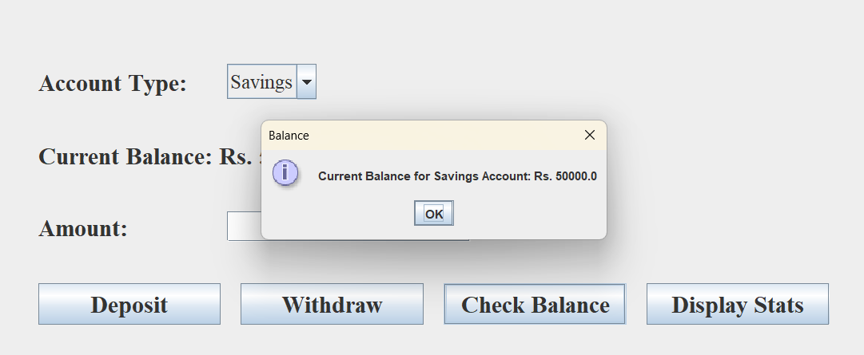
RESULTS
Fig 4: Balance of Saving Account

Slide 23
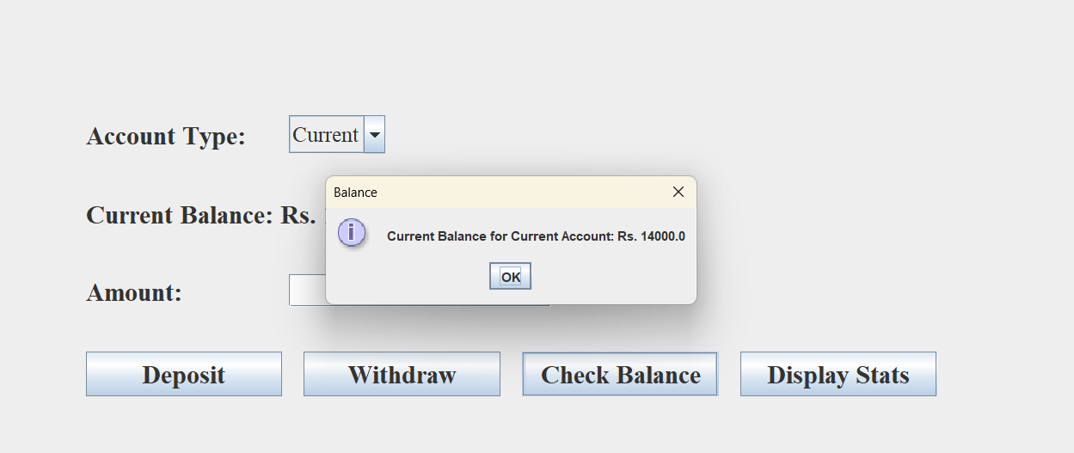
RESULTS
Fig 5: Bank Balance of Current Account

Slide 24
CONCLUSION
In conclusion, Bank Management System for Android enhances banking efficiency and user convenience. Integrating AI, machine learning, and biometric authentication provides personalized and secure services. Future expansions like augmented reality, voice banking, and IoT will further enrich user experiences. Collaborations with FinTech and open banking standards ensure comprehensive and seamless financial services, meeting evolving customer needs.

Slide 25
FUTURE SCOPE
Implementation of advanced biometric authentication (fingerprint, facial recognition) and AI-driven fraud detection mechanisms.
Integration of AI and machine learning for personalized customer experiences, predictive financial planning, and automated customer support through chatbots.
Offering additional services such as robo-advisors for investment, peer-to-peer lending, and cryptocurrency transactions through partnerships with FinTech companies.
Development of AR features to enhance user experience with virtual bank tours, interactive tutorials, and financial data visualizations.
Incorporation of voice banking services using virtual assistants like Google Assistant and Amazon Alexa, enabling users to perform banking tasks via voice commands.

Slide 26
REFERENCES
Singh, K., & Dutta, V. (2017). Commercial bank management. McGraw Hill Education.
Poole, W. (1968). Commercial bank reserve management in a stochastic model: implications for monetary policy. The Journal of finance, 23(5), 769-791.
Dener, C., Watkins, J., & Dorotinsky, W. L. (2011). Financial management information systems: 25 years of World Bank experience on what works and what doesn't. World Bank Publications.
Hossan Chowdhury, M. (2011). Ethical issues as competitive advantage for bank management. Humanomics, 27(2), 109-120.
Al-Dmour, R., & Rababeh, N. (2021). The impact of knowledge management practice on digital financial innovation: the role of bank managers. VINE Journal of Information and Knowledge Management Systems, 51(3), 492-514.

Slide 27


Thank you

